Slide 1


CHAPLAINCY 101
OFFICE OF TRAINING & DEVELOPMENT

Slide 2
CHAPLAIN VS. PASTOR:
WHAT’S THE DIFFERENCE?

Slide 3
CHAPLAIN VS. PASTOR
Individuals can look to religious leaders — such as chaplains and pastors — for spiritual guidance, moral support, and advice about life decisions.
Chaplains and pastors minister to individuals regularly by leading religious services or offering spiritual guidance.
They are both theologically educated and certified ministers.
Both are credentialed ministers or counselors.
Notes:
CHAPLAIN VS. PASTOR: WHAT’S THE DIFFERENCE?
Individuals with religious affiliations often belong to communities that share their same beliefs and world views. They can look to religious leaders — such as chaplains and pastors — for spiritual guidance, moral support, and advice about life decisions.
Chaplains and pastors minister to individuals regularly by leading religious services or offering spiritual guidance. The core responsibilities of the two roles are similar. Each occupation also necessitates an educational background in spiritual studies, such as a master’s in divinity or spiritual care. However, when considering the career path of chaplain vs. pastor, there are some differences.
Chaplains and pastors play a significant role in the lives of diverse groups of people. They are both theologically educated and certified ministers. However, their job descriptions vary in a few ways. An easy way to remember the difference is that while all chaplains are pastors, not all pastors are chaplains.
Pastors and chaplains are similar in many respects. Both are credentialed ministers or counselors.

Slide 4
CHAPLAIN VS. PASTOR
Differences between pastors and chaplains lie in where, how and to whom they offer counseling and care.
Pastors are associated with a specific church or parish, while chaplains are associated with specific employer or agency.
A chaplain is a certified clergy member in a non-religious organization.
- Chaplains can work in government roles and serve members of the military.
Notes:
Both provide counseling and spiritual ministry to those in need. However, differences exist between the two occupations. The primary differences between pastors and chaplains lie in where, how and to whom they offer counseling and care.
Pastors typically are associated with a specific church or parish, while chaplains generally are associated with specific employer or agency.
Although most pastors visit their members at home or in the hospital, most activities are church-based. Chaplains perform their duties beyond church walls.
Pastors deal with the doctrines, rituals, beliefs and morality specific to their denomination. Chaplains respect the right of all people to follow any religion or no religion at all.
Chaplains minister to a broader spectrum of people than most pastors.

Slide 5
CHAPLAIN VS. PASTOR
Pastors most activities are church-based.
- A pastor is an ordained clergy member who works in one religious organization.
- Pastors serve their congregation consistently by planning and overseeing weekly church services.
Chaplains perform their duties beyond church walls.
- Chaplains can also take on the role of a spiritual leader for individuals who do not belong to a specific religious community.
- Chaplains lead non-denominational religious services.
Notes:
Both provide counseling and spiritual ministry to those in need. However, differences exist between the two occupations. The primary differences between pastors and chaplains lie in where, how and to whom they offer counseling and care.
Pastors typically are associated with a specific church or parish, while chaplains generally are associated with specific employer or agency.
Although most pastors visit their members at home or in the hospital, most activities are church-based. Chaplains perform their duties beyond church walls.
Pastors deal with the doctrines, rituals, beliefs and morality specific to their denomination. Chaplains respect the right of all people to follow any religion or no religion at all.
Chaplains minister to a broader spectrum of people than most pastors.

Slide 6
CHAPLAIN VS. PASTOR
Pastors deal with the doctrines, rituals, beliefs and morality specific to their denomination. Chaplains respect the right of all people to follow any religion or no religion at all.
- Pastors usually volunteer a certain amount of their time.
Chaplains are commissioned by their organizations.
- Chaplains hold rank and wear an insignia to indicate their rank.
- Chaplains answer ultimately to the Commanding Officer through a chain of command in the unit.
Notes:
Both provide counseling and spiritual ministry to those in need. However, differences exist between the two occupations. The primary differences between pastors and chaplains lie in where, how and to whom they offer counseling and care.
Pastors typically are associated with a specific church or parish, while chaplains generally are associated with specific employer or agency.
Although most pastors visit their members at home or in the hospital, most activities are church-based. Chaplains perform their duties beyond church walls.
Pastors deal with the doctrines, rituals, beliefs and morality specific to their denomination. Chaplains respect the right of all people to follow any religion or no religion at all.
Chaplains minister to a broader spectrum of people than most pastors.

Slide 7
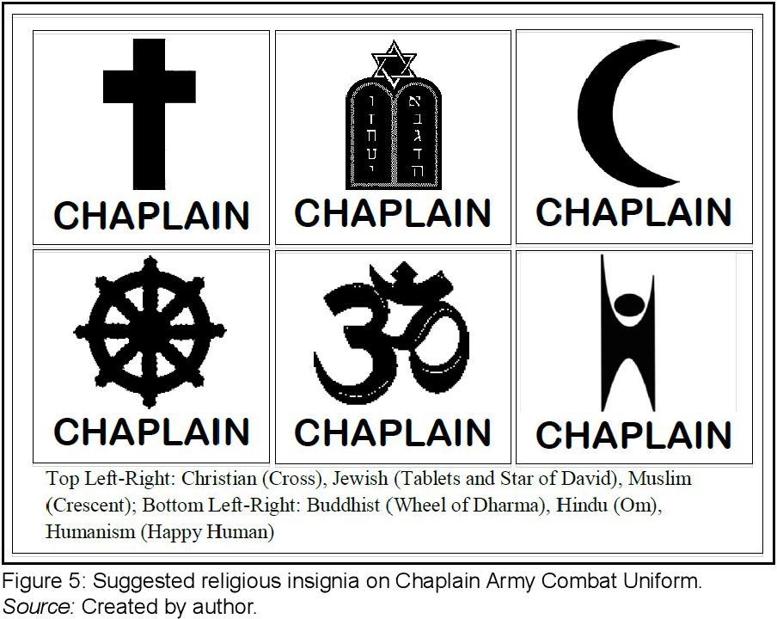
CHAPLAIN VS. PASTOR
The Chaplain represents his/her denomination, but wears a badge of a more general nature.
Chaplain wears some form of symbol specific to the individual chaplain’s religion.
Chaplains hold non-combatant status; i.e., they do not carry weapons.
Notes:
THE CHAPLAIN AS CLERGY
The Chaplain represents his/her denomination, but wears a badge of a more general nature.
Badges and insignia vary widely across nations and services; though generally include some form of symbol specific to the individual chaplain’s religion: Christian Cross, Jewish tablets, Buddhist wheel, Sikh crossed swords and Muslim Crescent moon.
Chaplains hold non-combatant status; i.e., they do not carry weapons.

Slide 8




THANKS FOR COMING

